Slide 1
AUTOMATA & COMPUTABILITY
CSE 331, CSE BRAC

Slide 2
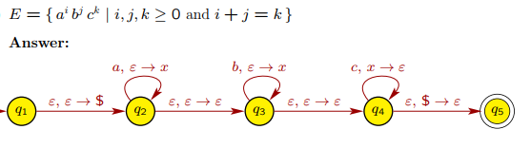
PDA Examples (..contd)

Slide 3
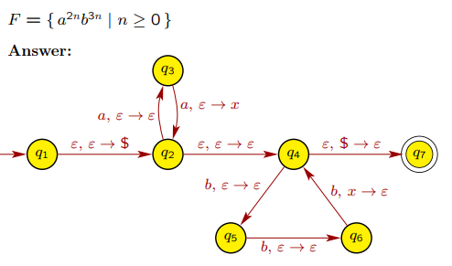
PDA Examples (..contd)

Slide 4
CNF Examples
Convert the following CFG to its equivalent CNF and then use the CYK algorithm to check if the given string belongs to the grammar or not. S → A 1 B A → 0A | ε B → 0B |1B| ε String for CYK: 01011

Slide 5
CNF Examples
Convert the following CFG to its equivalent CNF and then use the CYK algorithm to check if the given string belongs to the grammar or not. S → aSa | aBa B → bB | b String for CYK: abbb

Slide 6
CNF Examples
Home Work:
Convert the following CFG to its equivalent CNF and then use the CYK algorithm to check if the given string belongs to the grammar or not. S → EcC | aAE | AU A → aA | ε B → bB | ε C → cC | ε E → aEc | F F→ bFc | ε U → aUc | V V → bVc | bB String for CYK: aabcc

Slide 7
CFG Examples
Give grammars for the following two languages:
All binary strings with both an even number of zeroes and an even number of ones.
All strings of the form 0ª1^{b}0^{c} where a + c = b.

Slide 8
CFG Examples (..contd)
S → 0X | 1Y | ε X → 0S | 1Z (odd zeroes, even ones) Y → 1S | 0Z (odd ones, even zeroes) Z → 0Y | 1X (odd ones, odd zeroes)
S → T U T → 0T1 | ε U → 1U0 | ε

Slide 9
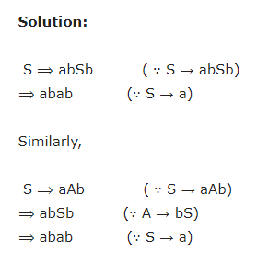
CFG
Show that the grammar G with productions
S → a | aAb | abSb A → aAAb | bS
is ambiguous.

Slide 10
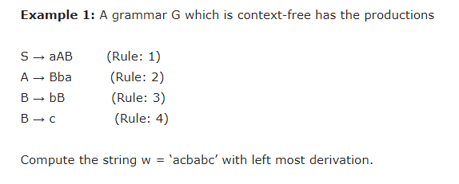
CFG leftmost derivations

Slide 11
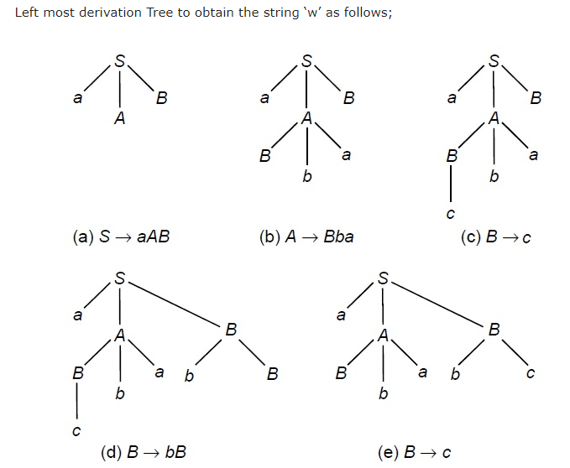
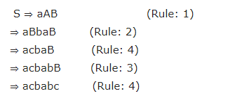
CFG leftmost derivations (..contd)

Slide 12
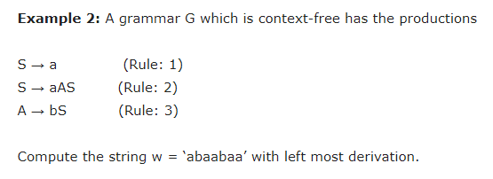
CFG leftmost derivations

Slide 13
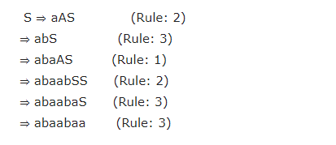
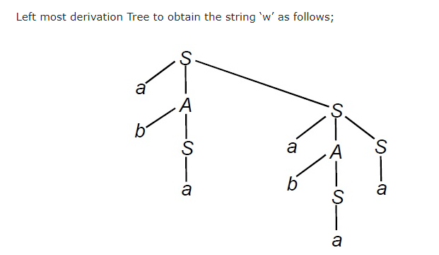
CFG leftmost derivations (..contd)

Slide 14
Thank You

